Slide 1
Distributed Database Systems
Autumn, 2017
Chapter 11 – Part 3 of 3
Distributed Concurrency Control

Slide 2
Optimistic Concurrency Control Algorithms
Section 11.5

Slide 3
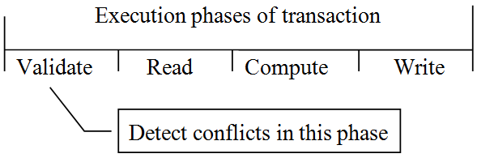
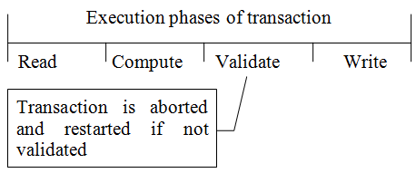
11.5 Optimistic Concurrency Control Algorithms
Pessimistic algorithms assume conflicts happen quite often.
Optimistic algorithms delay the validation phase until write phase.

Slide 4
Concepts
Timestamps are only associated with transactions, but not with data items.
Timestamps are assigned at the beginning of validation phase, but not the initialization of transactions.
T_{i} | A transaction
T_{ij} | a sub-transaction of T_{i} executed at site j

Slide 5
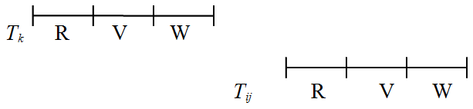
Local validation of T_{ij} – Rule 1
If all T_{k} with ts(T_{k}) < ts(T_{ij}) have completed before T_{ij} has started, then the validation succeeds.
This is a serial order.

Slide 6
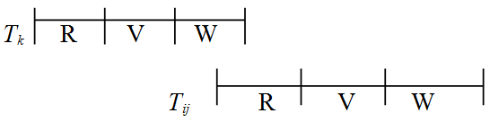
Local validation of T_{ij} – Rule 2
If there is any transaction T_{k} , s.t.
ts(T_{k}) < ts(T_{ij}), and
T_{k} is in write phase, and
T_{ij} is in read phase, and
WS(T_{k}) ∩ RS(T_{ij}) = ∅
then the validation succeeds.

Slide 7
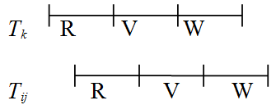
Local validation of T_{ij} – Rule 3
If there is any transaction T_{k} , s.t.
ts(T_{k}) < ts(T_{ij}), and
T_{k} completes the read phase before T_{ij} completes the read phase, and
WS(T_{k}) ∩ RS(T_{ij}) = ∅ , and
RS(T_{k}) ∩ WS(T_{ij}) = ∅
then the validation succeeds.

Slide 8
Global validation
There is no known optimistic method for doing it!
One pessimistic method for doing it
A transaction is globally validated if all the transactions that precede it in the serialization order (at that site) terminate i.e. commit/abort.

Slide 9
Conclusion
Advantages of optimistic algorithm
higher concurrency.
Disadvantages
higher storage cost for ordering of transactions.
No implementation at the time of writing the textbook.

